Slide 1

Chapter 24
Congestion Control and
Quality of Service
24.<number>
Copyright © The McGraw-Hill Companies, Inc. Permission required for reproduction or display.

Slide 2
24-1 DATA TRAFFIC
The main focus of congestion control and quality of service is data traffic. In congestion control we try to avoid traffic congestion. In quality of service, we try to create an appropriate environment for the traffic. So, before talking about congestion control and quality of service, we discuss the data traffic itself.
Topics discussed in this section:
Traffic Descriptor
Traffic Profiles
24.<number>

Slide 3

Figure 24.1 Traffic descriptors
Average datarate= amount of data/time
Peak data rate: maximum data rate of the traffic
Maximum burst size: Maximum length of time the traffic is generated at the peak rate:
24.<number>

Slide 4

Figure 24.2 Three traffic profiles
24.<number>

Slide 5
24-2 CONGESTION
Congestion in a network may occur if the load on the network—the number of packets sent to the network—is greater than the capacity of the network—the number of packets a network can handle. Congestion control refers to the mechanisms and techniques to control the congestion and keep the load below the capacity.
Topics discussed in this section:
Network Performance
24.<number>

Slide 6

Figure 24.3 Queues in a router
24.<number>

Slide 7

Figure Packet delay and throughput as functions of load
24.<number>

Slide 8
24-3 CONGESTION CONTROL
Congestion control refers to techniques and mechanisms that can either prevent congestion, before it happens, or remove congestion, after it has happened. In general, we can divide congestion control mechanisms into two broad categories: open-loop congestion control (prevention) and closed-loop congestion control (removal).
Topics discussed in this section:
Open-Loop Congestion Control
Closed-Loop Congestion Control
24.<number>

Slide 9

Figure 24.5 Congestion control categories
Admission policy for QoS
24.<number>

Slide 10

Figure 24.6 Backpressure method for alleviating congestion
Back pressure: Can be applied to virtual circuits
Every node when it gets congested, stops receiving packets from immediate node from upstream, by informing it to slowdown.
The backpressure builds in subsequent nodes and thus congestion is handled.
24.<number>

Slide 11

Figure 24.7 Choke packet
Choke packet is a packet sent by a node to the source to inform it of congestion. Uses ICMP message to inform the congestion.
24.<number>

Slide 12
Conngestion
Implicit Signaling: No communication between congested node and source. The sources guesses about congestion.
Explicit Signaling: Explicit information is sent as part of data packet. (Choke packet is a separate packet. )
  Backward signaling: bit sent to source
  Forward signaling: bit sent to destination
24.<number>

Slide 13
24-4 TWO EXAMPLES
To better understand the concept of congestion control, let us give two examples: one in TCP and the other in Frame Relay.
Topics discussed in this section:
Congestion Control in TCP
Congestion Control in Frame Relay
24.<number>

Slide 14

Figure 24.8 Slow start, exponential increase
24.<number>

Slide 15

Note
In the slow-start algorithm, the size of the congestion window increases exponentially until it reaches a threshold.
24.<number>

Slide 16

Figure 24.9 Congestion avoidance, additive increase
24.<number>

Slide 17
Note
In the congestion avoidance algorithm, the size of the congestion window increases additively until
congestion is detected.
24.<number>

Slide 18
Note
An implementation reacts to congestion detection in one of the following ways:
❏ If detection is by time-out, a new slow
start phase starts.
❏ If detection is by three ACKs, a new
congestion avoidance phase starts.
24.<number>

Slide 19

Figure 24.10 TCP congestion policy summary
24.<number>

Slide 20

Figure 24.11 Congestion example
24.<number>

Slide 21
Congestion control in frame relay
High throughput and low delay are the main goals of the frame relay protocol.
Congestion avoidance:
  Backward Explicit Congestion notification (BECN)
  Forward Explicit Congestion notification (FECN)
24.<number>

Slide 22
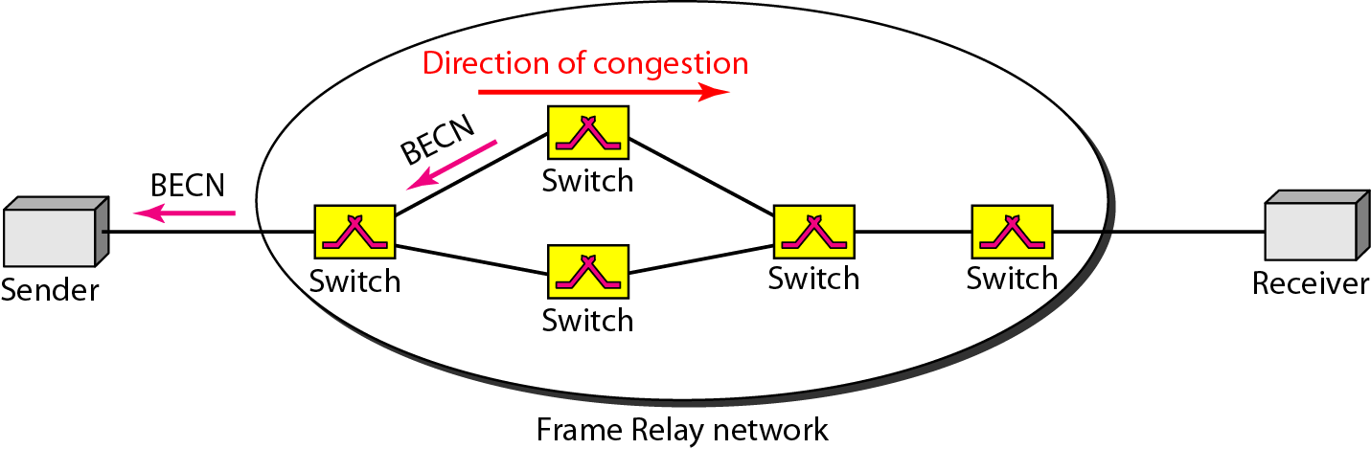
Figure 24.12 BECN
Switch can use response message for sending BECN or it can send
Special frames on a predefined connection
24.<number>

Slide 23
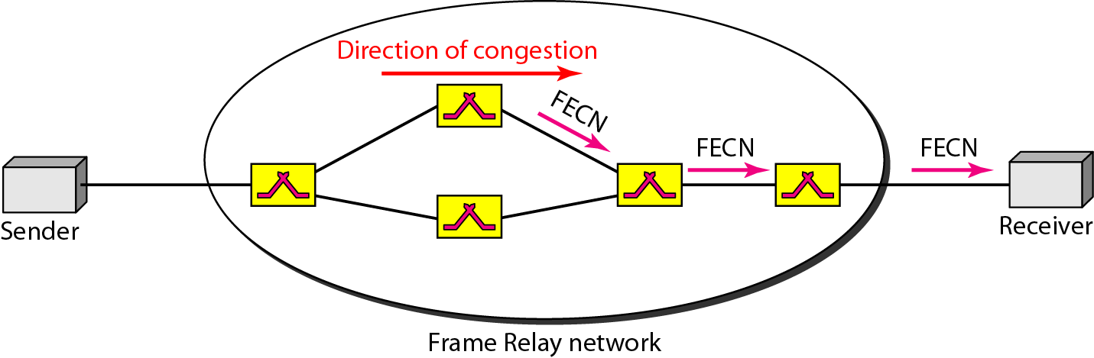
Figure 24.13 FECN
Warn the receiver by delaying the ACK
24.<number>

Slide 24
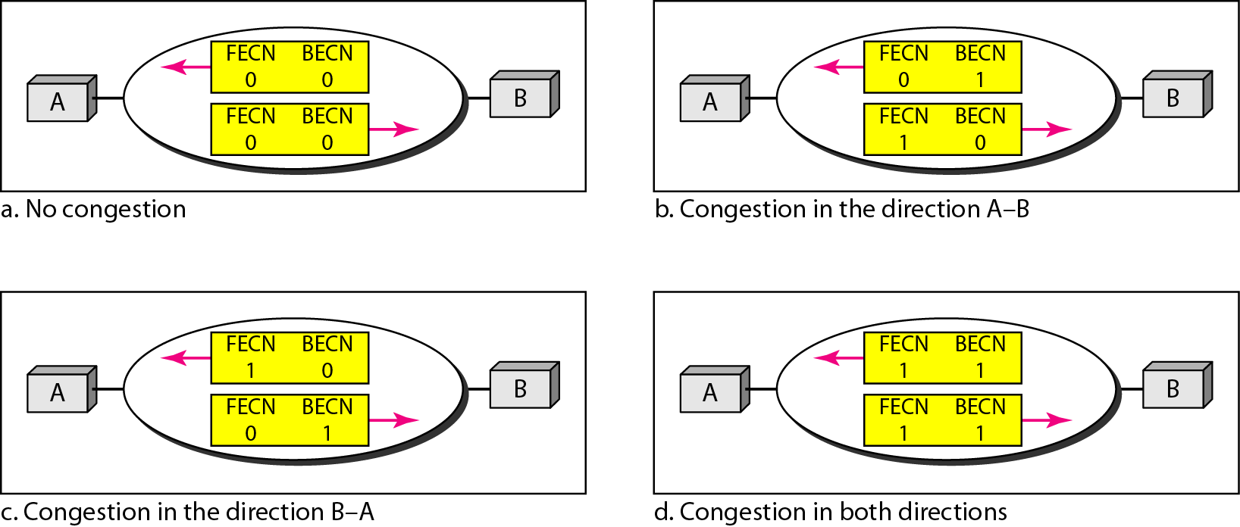
Figure 24.14 Four cases of congestion
24.<number>

Slide 25
24-5 QUALITY OF SERVICE
Quality of service (QoS) is an internetworking issue that has been discussed more than defined. We can informally define quality of service as something a flow seeks to attain.
Topics discussed in this section:
Flow Characteristics
Flow Classes
24.<number>

Slide 26

Figure 24.16 FIFO queue
24.<number>

Slide 27
Techniques to improve QoS
Scheduling
  FIFO queuing
  Priority Queuing
  Weighted Fair Queuing
Traffic Shaping
  Leaky Bucket
  Token Bucket algorithm
Resource Reservation
Admission Control
24.<number>

Slide 28

Figure 24.17 Priority queuing
24.<number>

Slide 29

Figure 24.18 Weighted fair queuing
24.<number>

Slide 30

Figure 24.19 Leaky bucket
24.<number>

Slide 31

Figure 24.20 Leaky bucket implementation
24.<number>

Slide 32
Note
A leaky bucket algorithm shapes bursty traffic into fixed-rate traffic by averaging the data rate. It may drop the packets if the bucket is full.
24.<number>

Slide 33
Note
The token bucket allows bursty traffic at a regulated maximum rate.
24.<number>

Slide 34

Figure 24.21 Token bucket
24.<number>

Slide 35
THANK YOU
24.<number>

